Slide 1
Sprint 1 Retrospective
TEAM 1

Slide 2
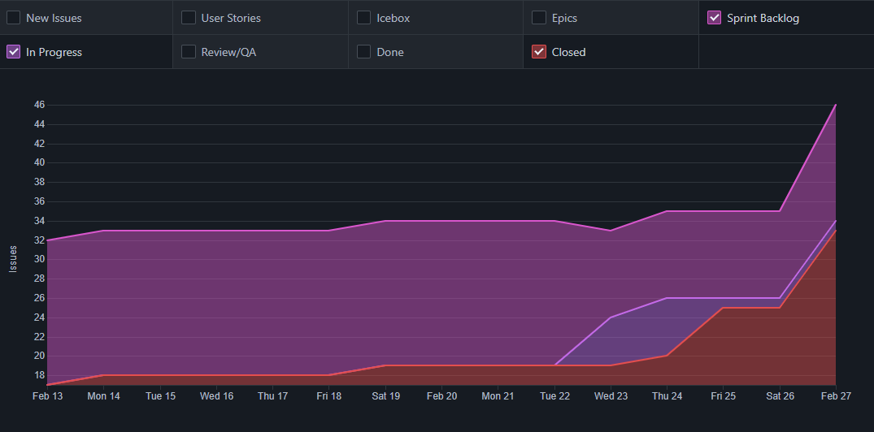

Slide 3
What worked well?
Stand up meetings and meeting frequency
Pull request description, code coverage, linking user stories
Pull request review process
Django unit testing

Slide 4
What could be improved?
Acceptance criteria process needs to be improved/more descriptive
Sprint ramp up time
Utilize ZenHub more throughout the sprint (Using pipeline, labeling sprints/progress)
Overestimated points for sprint backlog
Splitting more complicated user stories into smaller ones

Slide 5
What changes we are making?
Improve user story template for acceptance criteria
Require acceptance criteria to be filled out before it is in progress
More realistic target for sprint 2 backlog
More pair programming

